Slide 1
TF-IDF, SVM, Logistic Regression & AUC-ROC Curve Final Project
Carla Kim Gaieski 2020195176

Slide 2
The problem set
The problem set provided three different cases for the application of TF-IDF, SVD, Logistic Regression, and AUC-ROC curve. In each scenario the target dataframe, to be used together with the matrix, converted into a dataframe, from the SVD, changed. This way, it would be possible to generate three different logistic regression models.
Instead of using multiple confusion matrices for each threshold that we considered important, a ROC (Receiver Operator Characteristic) curve can summarize the information of the matrices.
Y-axis indicates the True Positive Rate (which is equivalent to the sensitivity; true positives/ true positives + false negatives), that indicates the proportion of the samples that were correctly classified.
X-axis indicated the False Positive Rate (which is equivalent to 1-Specificity; false positives/ false positives + true negatives).

Slide 3
The problem set
With the completed ROC curves, it is possible to then use AUC (Area Under the Curve) to compare each ROC curve with one another and choose which categorization is better. The curve with the greater area is the better curve to consider for threshold and correct classification.
The closer the area is to 1, the better, and for it to be considered a good classifier
0.5<Area<1 is a good classifier: the model can classify the positives and negatives well.
Area lower or equal to 0.5: the model is not good, and not able to distinguish between the positives and negatives, meaning that it cannot predict well.
Logistic regression it is also possible to get the coefficient of the regression, which can be used to indicate the feature importance.

Slide 4
Cases
The procedure for all cases were the same:
The data frame containing documents and terms was cleaned - replace special character with blank space, split into words, that if greater than three, it will be joined, and lastly all letters were lower cased)
Data frame was tokenized - splitted into a series of words, grouped into a list
Data frame was vectorized by the TF-IDF, to measure the importance of a word, by highlighting the words that are frequent within one specific document.
Apply SVD (Singular Value Decomposition) → get the U matrix, that contains 1000 rows and 20 columns.
Make it a new dataframe to use as X in the regression models for all three cases.

Slide 5
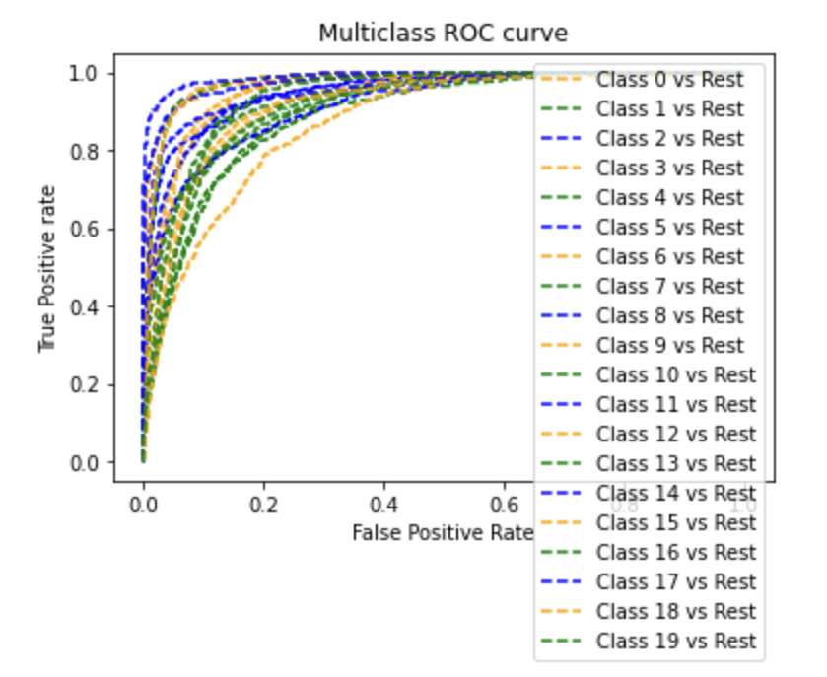
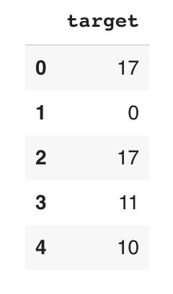
Case 1
Run logistic regression between the X and Y(target) → accuracy of 56%.
The accuracy of 56% is not the greatest nor the desired result to accomplish when performing a regression analysis. However, given the time for producing the model, it is not a bad result, which leaves room for improvement for the model, to elevate its accuracy.
ROC curve, it is possible to plot all of the thresholds together in the same graph, which makes it possible to compare one class(variable) to all the others. This curve can already indicate that the model does not perfectly distinguish between positives and negatives, but there should be at least one class with a high AUC.

Slide 6
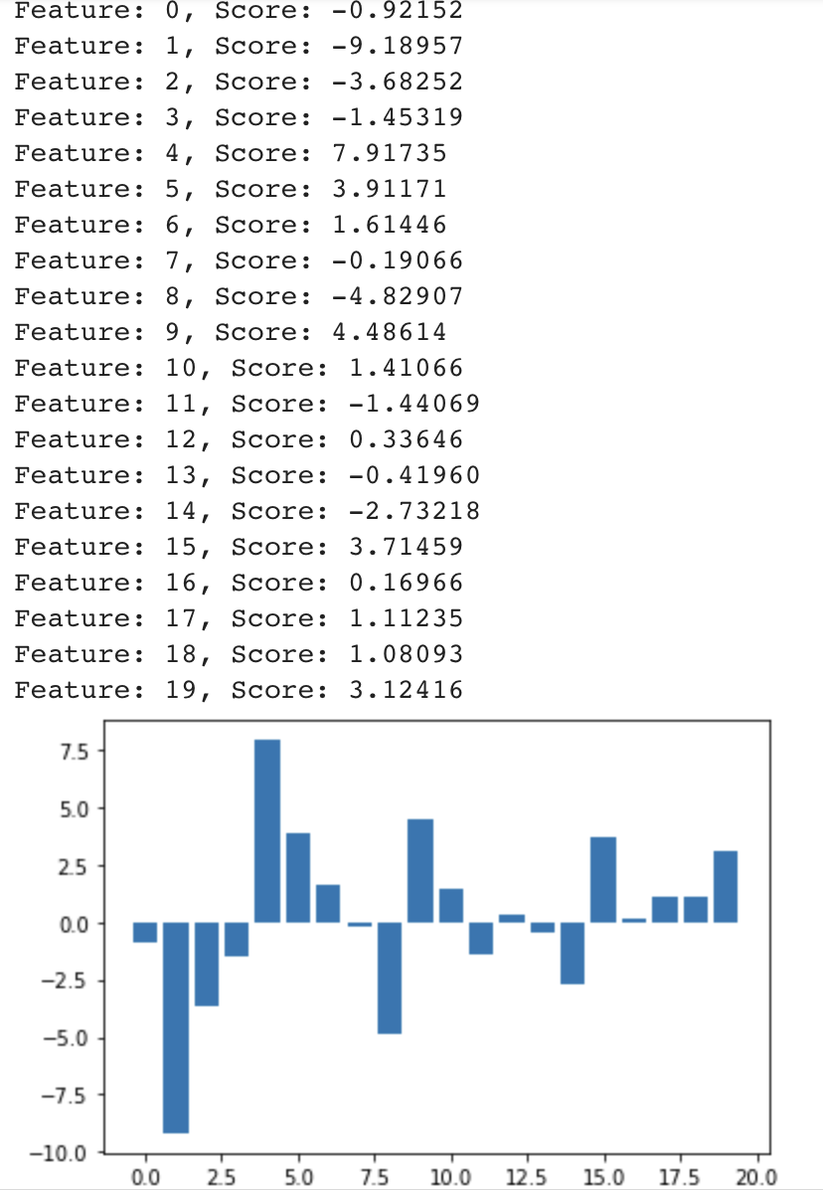
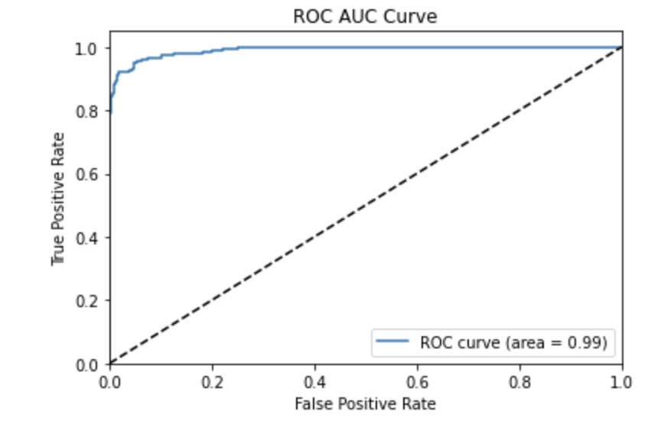
Case 1
Multiclass problem, the multiclass ROC curve makes it harder to evaluate each feature to its fullest. So, it is necessary to plot individual ROC curves for each class that the dataframe has. When plotting all the different class ROC-AUC curves, there are many curves with the area of 0.80, but there is one class which has an AUC of 0.99, being the highest of them all. The feature with the highest area is the feature 17.

Slide 7
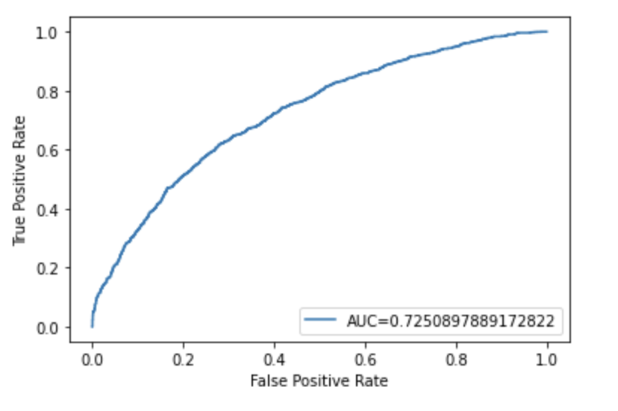
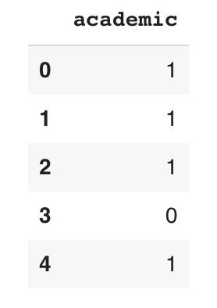
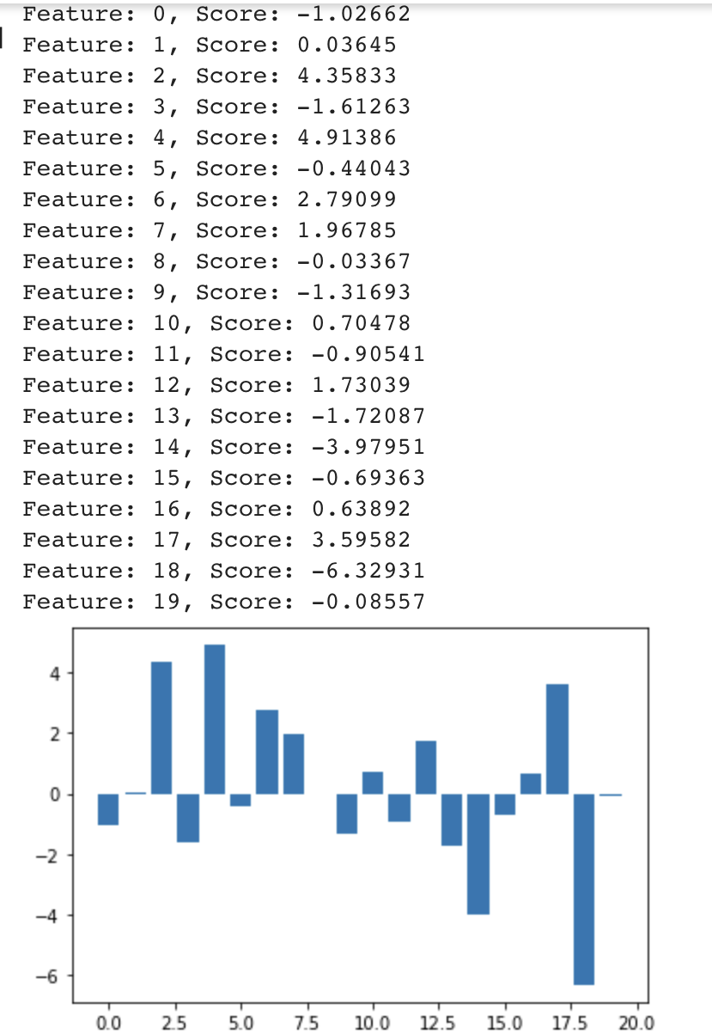
Case 2
Create a new target dataframe, to be used as the Y in the logistic regression. The new target dataframe was based on the sender's e-mail, if it was academic or not, meaning if the sender's e-mail finished with “.edu” or not. This made it possible to create a binary dataframe where 1 indicated academic and 0 non academic.
Logistic regression, it was possible to achieve a higher coefficient for this model, of approximately 66%.
The new target dataframe is better to be compared with the document dataframe

Slide 8
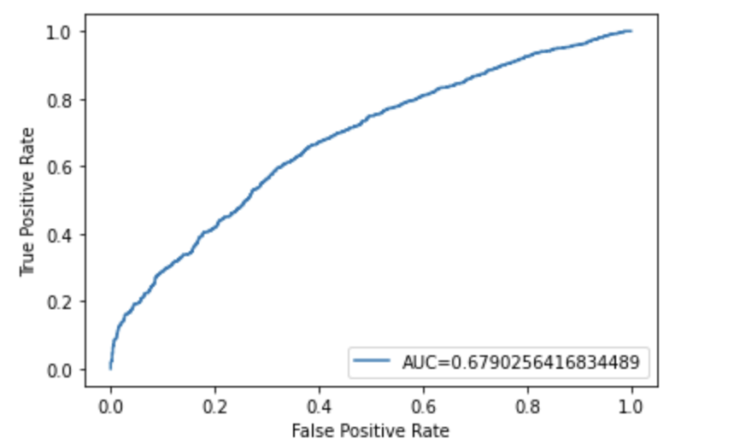
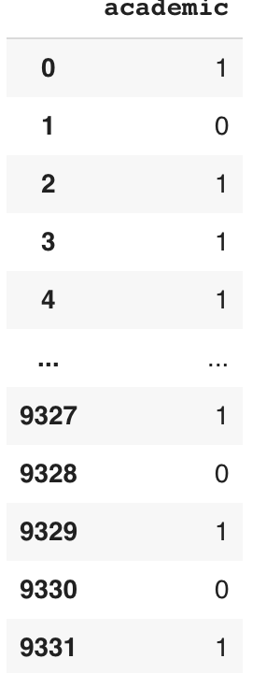
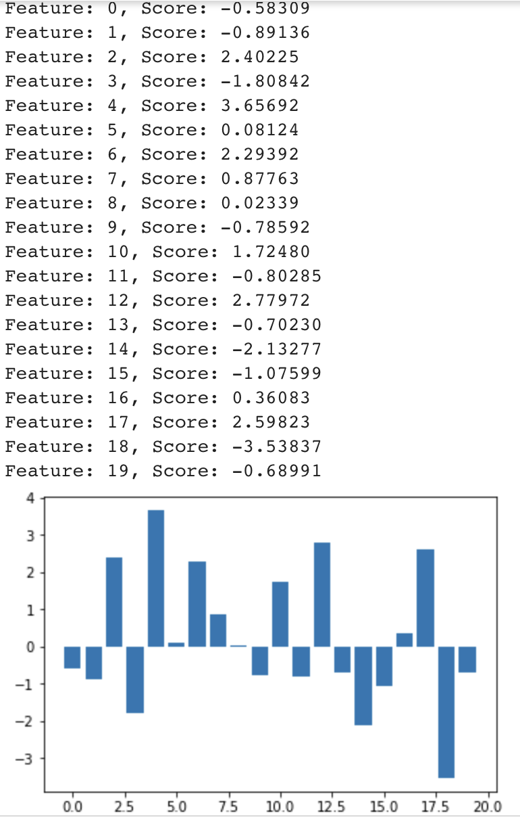
Case 3
Create new dataframe for receivers
Some e-mails were missing the “To” part, which made them a NaN. A NaN, when being dropped caused the issue of the entire row being deleted, which created the imbalance when running the regression.
Run the logistic regression and get a coefficient of 62%
The ROC curve provided an AUC of 0.67, which is also a good number. It is between 0.5 and 1, which also means that the classifier can distinguish between the positive and negative points.

Slide 9
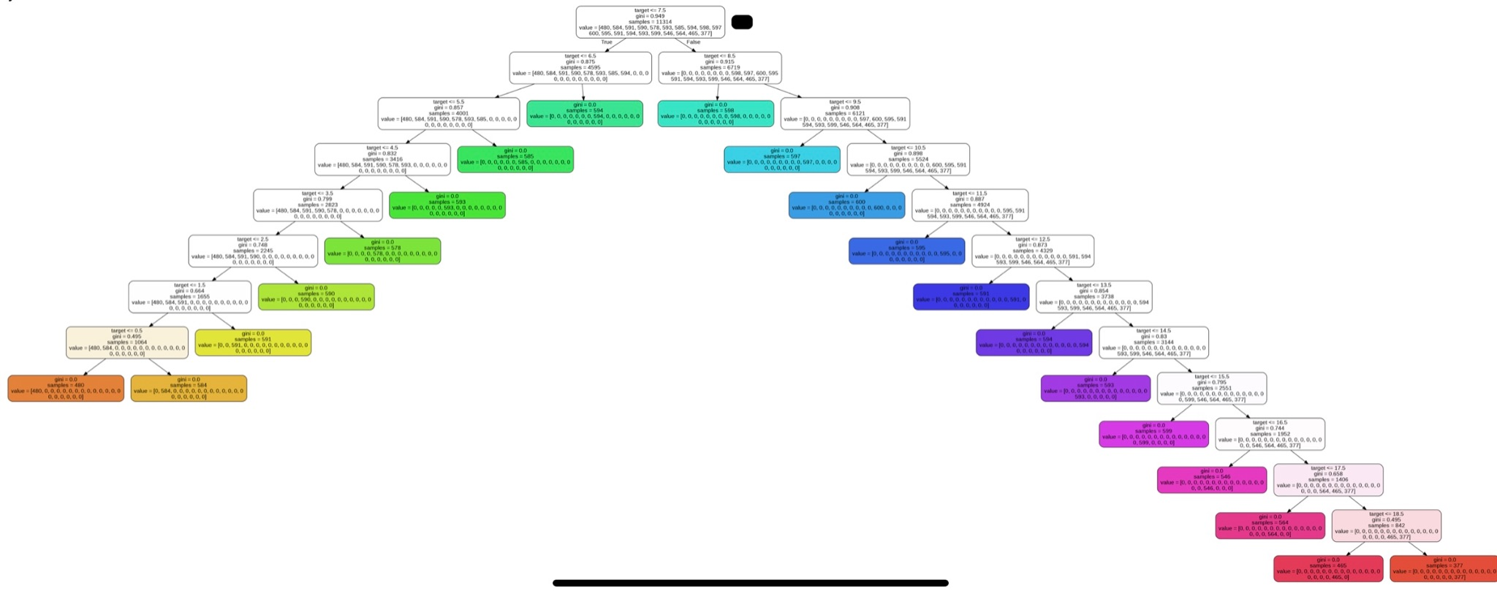
Case 4 - Case 1
Case 4 required more time for development and analysis, in order to create decision trees and individual explanation. However, it was only possible to plot a decision tree for the first case, with the dataframes that were already given in the problem set. It shows many branches and nodes. All of the nodes carry the Gini index of 0, which cancels any uncertainty that could have on the classification made with the tree, as it means no impurity. The targets that keep on diving have Gini’s that are not 0.0, and until they meet certain conditions, it will keep branching downwards.

Slide 10
Conclusion
The accuracy of the models, overall, were not the desired ones, however, it was still successful to indicate a good outcome on the models.
There is room for improvements, but the problem of overfitting should be considered too, so it doesn’t create a worst model, with AUC equal or lower than 0.5, or a regression model with a low coefficient.
Each case showed its own good qualification model, and out of the three, the one with the best performance was the Case 2, and the AUC-ROC curve with the highest area was the feature 17 in Case 1. Case 3, however, had a higher AUC than Case 2 (a comparison as these two cases were not a multiclass one like case 1).

Slide 11
Thank you

